Slide 1
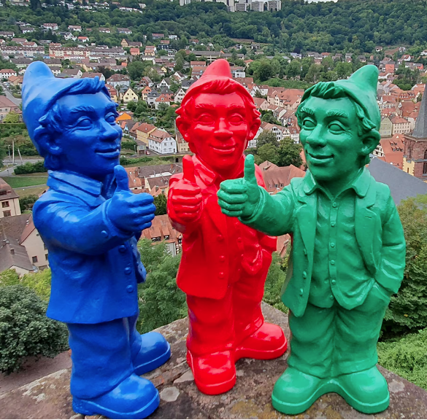
2024 Budget
First Meeting- 8/8/2023

Slide 2
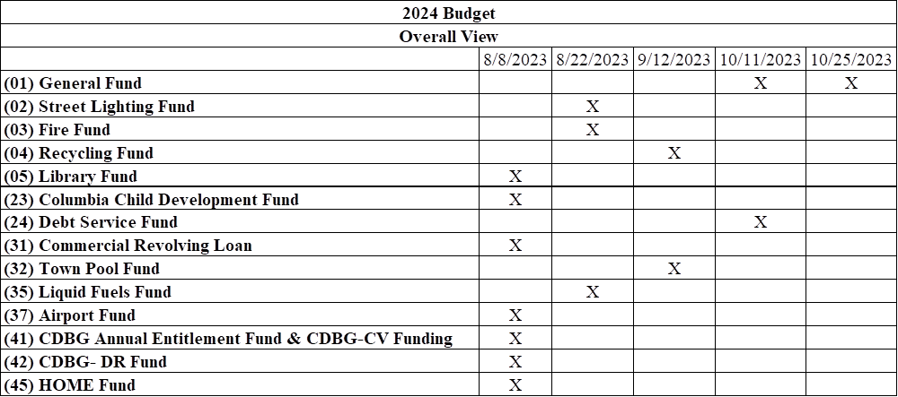

Slide 3
Mill of tax will be valued at $125,000 for 2024.

Slide 5
Library fund
Lydia Kegler will present.
  Handout titled, “Bloomsburg Public Library”.
Interest from Council to remain at the .20 tax mill or increase to the requested .30 mills?

Slide 6
If Tax Mill stays at .20

Slide 7
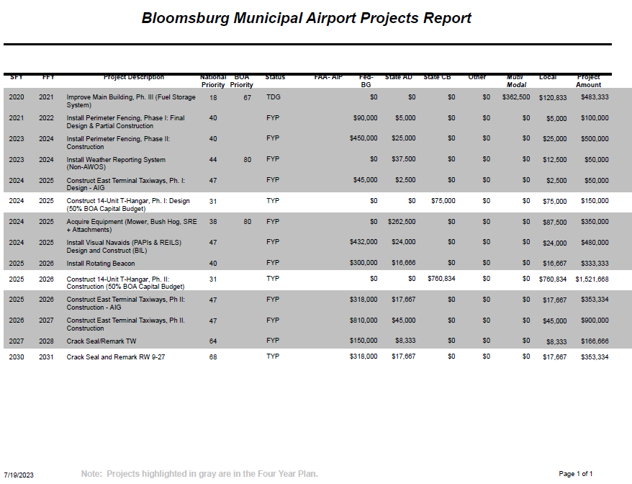
Airport fund 37, not the general fund airport department

Slide 8
Airport fund 37
  Perimeter Fence – Terminal Area
    Separate airside and landside
    Minimize inadvertent or unauthorized entry
    Increase security of fuel tank
  Rotating Beacon
    Replace beacon with new energy efficient LED equivalent
    New tip down tower to increase ease of maintenance
    Current pole requires climbing for service
  T-Hangar Building
    8-unit building
    Attract more based aircraft
    Increase fuel sales
    Generate revenue from rent payments
  East Terminal Taxiway
    Provides paved access to proposed T-hangar
    Improves existing hangar taxi lane
      Pavement condition
      Meet FAA design standards

Slide 9
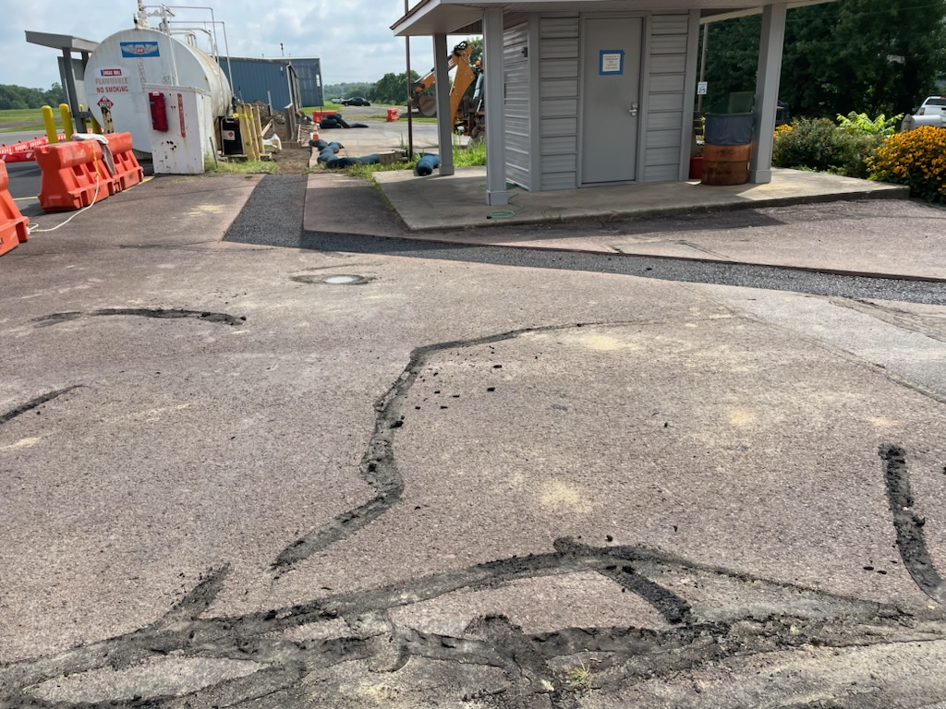
Airport fund
We have $122,000 of federal funds expiring June 30th.
  100% federal, no local share.
  Costs must be incurred by March 31, 2024.
    Is there a majority to move towards this project for a perimeter fencing around the fuel farm?

Slide 10
Airport fund- hangar

Slide 11
Airport fund- hangar

Slide 12
Airport fund- HANGAR
-Is there backing to have staff explore two grants in order to have a meaningful project?
- $100 application fee is needed
-Deadline for the one grant is 11/30/2023
-Deadline for the other grant is 08/31/2023
- Resolutions at Council meetings are needed
-Over 25 years- $1,050,000 of revenue could be made (assumes full occupancy)
-2023 Budget will not be made until these two topics are discussed

Slide 13
Columbia Child Development center
FUND 23
Bank balance at 8/7/2023: $74,253.40
Transfer needed for 2023: ($15,000.00)
September – December payments needed $6,597.96
Bank balance remaining at 12/31/2023: $65,851.36
$1,649.49 2023 monthly compared to $1,527.03 2022 monthly. Increased $122.46 compared to prior year.
50 year lease started April 1, 1988- 2038

Slide 14
IF COUNCIL WISHES TO TRANSFER $15k to General FUND

Slide 15
COMMERCIAL revolving loan FUND 31
During the 2023 budget session Council earmarked these funds to pay for the annual $44,000 floodwall maintenance. It will take 5.27 years to deplete the fund balance as of 12/31/2023: $231,864.74.

Slide 16
CDBG & CDBG-CV- Fund 41
CDBG-CV- No 2024 projects are anticipated
  Park Walking Trail has been completed
  Airport Fuel Farm will hopefully be completed in 2023
CDBG Entitlement 2024 will be applied to the parking lot renovation projects
  $265,000 annual allocation
    $235,000- Loan payoff
    $30,000 anticipated for administrative payments

Slide 18
CDBG-DR FUND 42
CDBG-DR Honeysuckle – Period of Performance ends 12/30/2023. There may be minor grant closeout items needed; however, funds should be expended before 12/30/2023.
FMA 2019 – Set to expire on 9/23/2024. SEDA-COG sent one last invoice last week for the final site visit. Once the final payment is made, then we can confirm to PEMA and the State can issue the return of funds letter. We anticipate this grant will be closed out by the end of 2023.
FMA Swift Current – A budget of $351,241 has been awarded for this elevation project (334 E. 9th Street). We are awaiting a fully executed Agreement between PEMA and the Town to be released (the Town has signed). Once a fully executed Agreement is in place, SEDA-COG will present a PSA for project management/grant administration. Once a PSA is in place, SEDA-COG will begin work to draft an RFQ for Engineering services. Goal is for an engineer to be on board before the end of 2023, have the engineer begin their work (design, specifications) in early 2024, and let the bids in the spring (pending no issues) with construction in 2024.
FMA 2022- We have not been notified if the 102 Leonard Street acquisition/ demolition has been selected/ identified for further review.

Slide 20
HOME fund 45
We were awarded $500,000. The approximate balance is $340,000. Funds expire May 19, 2024. The Town will most likely entertain extending the termination date 3 months prior to the funds expiring. The hurdle is: lack of homeowners getting back to SEDA-COG and lack of contractors.

Slide 21
Next meeting
8/22/2023 at 10 a.m.

